Slide 1

2019 ASQ World Conference on Quality and Improvement
Site Volunteer Training and Evaluation
Fort Worth Convention Center, Fort Worth, TX
May 18-22, 2019

Slide 2



Welcome to Fort Worth, Texas!
We are delighted to have you as a volunteer for the 2019 WCQI. Thank you!
We look forward to working with you to help make the 2019 WCQI a most enjoyable and rewarding experience for the more than 2500 attendees.
Please review this training material and successfully complete the quiz by April 10, 2019 to be assigned a final volunteer schedule and receive your complimentary registration code. A link to the quiz is at the end of this presentation and on the WC19 Volunteer webpage .
You are not expected to memorize these contents; information is provided to help prepare you for your role as a volunteer.
In addition to this ONLINE training, you must attend ONE ONSITE training session prior to your first assignment. This is mandatory.

Slide 3
Training Objectives
  By the end of this training you will know how to:
  Describe the different volunteer functions and responsibilities
  List the resources available to volunteers
  Provide excellent customer service that meets or exceeds WCQI guidelines
  Answer frequently asked WCQI-related questions

Slide 4
Topics
  General WCQI Information
  Volunteer Roles and Responsibilities
  Customer Service Expectations
  Resources
  Next Steps
  Quiz

Slide 5
General WCQI Information
WCQI Theme & Focus Areas
Venue
Session Types
Badges
Volunteer Registration

Slide 6

Conference Theme – Leading Change
Change has always been constant, but in today’s digital landscape the pace of change is accelerating at a faster and faster rate. This creates both challenges and opportunities for organizations and for the quality profession at large. There are those who will meet these challenges and opportunities proactively and others who will wait and be forced to be reactive in their response. Within this dynamic is the opportunity for quality professionals to lead their organizations through the changes that each is destined to go through. The future is NOW, and both organizations and individuals have a choice to either lead the change it is bringing or be led by the change that occurs. It is within these disruptive conditions that ASQ invites you to Fort Worth for the 73rd hosting of the World Conference on Quality and Improvement.
LEARN · CONNECT · ENGAGE · GET INSPIRED
Each year, thousands gather at this premier quality event to share best practices, expand their network, and further develop their professional growth. The body of tools, techniques, and methods that quality encompasses is ever growing, and the digital transformation of today is filled with opportunity to expand the development of new approaches that will affect how quality principles are applied tomorrow.

Slide 7
Focus Areas
The Future of Quality: The sessions in this area examine the effects disruptive technologies are having on the quality function and on the quality profession as a whole.
Managing Change: Today’s ever-changing landscape of disruption and transformation requires organizations to change and constantly challenge past practices.
Building and Sustaining a Culture of Quality: These sessions address the struggle of how to build a culture in which the application of quality tools, techniques, and methods expands beyond special projects or departments and evolves into the standard way work gets done.
Quality Basics: This area focuses on ADVANCED content designed to provide new, innovative, and unique insight and perspective to experienced practitioners and leaders. These sessions offer advanced content covering the more complex and intricate technical areas of the quality discipline.

Slide 8
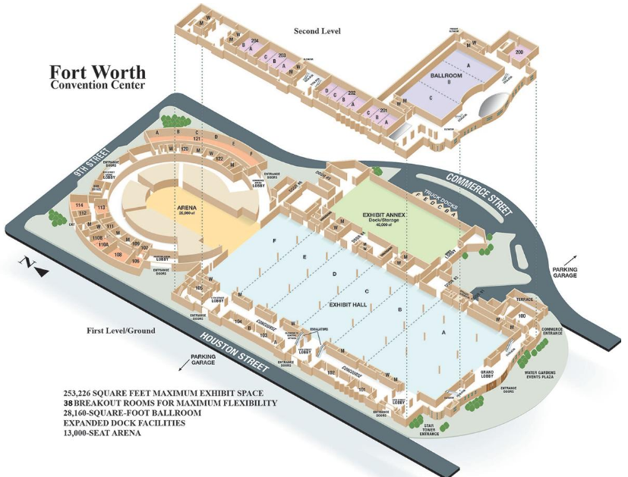
Venue
Site Room

Slide 9
Session Types
Concurrent Session: These 60-minute sessions are meant to present real applications, results, and solutions based on quality principles or theory that can be implemented immediately.
Workshop: Workshops will lead participants from an identified beginning point through a logical and clearly identified end point with the expansion of the related body of knowledge and include hands-on learning activities that demonstrate and reinforce the concepts presented.
“After 5” Sessions: These exciting and innovative sessions are less formal than concurrent sessions and cover numerous topics that may not relate directly to quality in the traditional sense. They include a social component which adds to the level of interaction between the facilitator and the participants, as well as the participants and their peers.

Slide 10
Session Types
LIVE Case Studies: These unique sessions will take you on a journey through successful quality projects from around the world. Hear how other companies have made a significant impact on their organizations using proven quality methodologies, tools and techniques.
Quality 4.0 Theater Sessions: Whether it be called Industry 4.0, Disruptive Technology or the Digital Revolution, the exponential growth of technology is rapidly changing the workforce, workplace and markets that organizations serve. These “TED-Style” talks explore the impact that artificial intelligence, robotics and other technological advances will have on organizations as well as the future of quality and the quality professional.

Slide 11
Attendee Badge Color Codes
Green
Attendee
Black
Staff / Volunteer
Blue
Speaker
Red
Exhibit Hall
Only persons holding a Green, Black or Blue badge are allowed to attend sessions.
Persons with a Red badge & Persons without a badge should not be admitted to sessions.
Notes:
.

Slide 12
Volunteer Registration
As a volunteer, the conference fee is at no cost if you work all your scheduled activities. Your registration includes admission to the following:
  Keynote Speaker Sessions
  WCQI Concurrent Sessions
  Workshops
  Industry Sessions
  Professional Sessions
  Exhibit Hall
Your registration as a volunteer does not include:
  Member-Leader events (separate registration)
  “Invitation Only” events
  Meals or Tuesday Evening Reception
  Events requiring a special ticket for an additional fee
  Parking

Slide 13
Volunteer Roles and Responsibilities
Roles
Responsibilities
Notification Requirements
Notes:
Now

Slide 14
Volunteer Roles
ROLES | VOLUNTEERS FOR EACH SESSION OR LOCATION
Session Monitors: Concurrent Sessions / Workshops | Two (2) for each session
Keynote / General Session | Four (4) for each session
Live Case Studies | Two (2) for each session
Information Desk | Two (2) for each desk
Site Room: Sign Volunteers In / Out, Backup | Four (4) in Site Room
Lunch Tickets | One (1) for each line

Slide 15
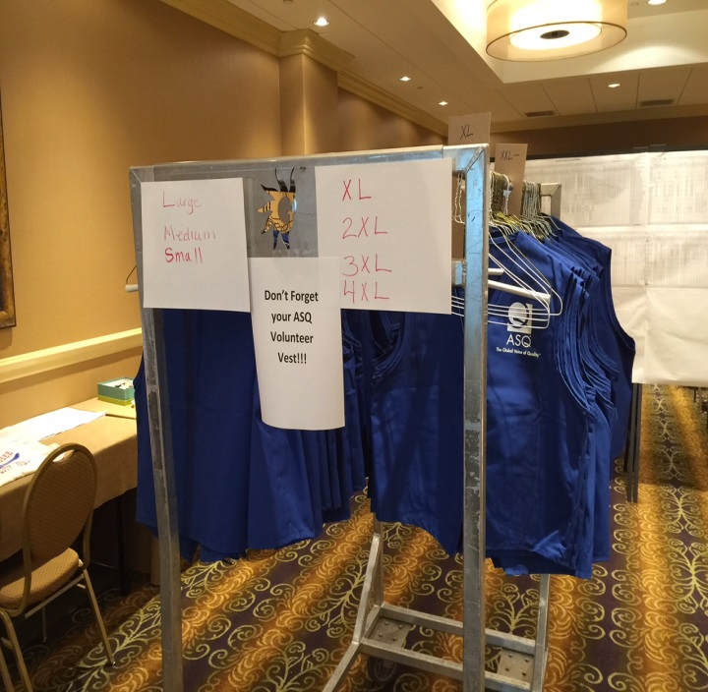
Responsibilities
When you arrive:
Check-in: Site Committee Room 103 (Central communications point of contact for volunteers in the Fort Worth Convention Center)
- no later than 30 minutes prior to your first assignment of the day
Attend On-Site Volunteer Training. Training schedule (to be shared in the coming weeks) will contain the dates and times.
Wear your WCQI volunteer vest (distributed per assignment period)
Pick up your Volunteer Information during training
Pick up and review latest schedule updates (daily addendum)
All volunteers are required to check-in and check-out for each assignment period.

Slide 16
Responsibilities
While you are working:
Breaks: coordinate times with your partner or other Site Committee members
Dress - business casual; jeans/shorts/t-shirts or shirts with advertising not permitted.
Wear very comfortable shoes; there will be a lot of walking.
You may carry a water bottle; please do not carry other food or beverages.
Be enthusiastic . . . Smile!
Wear your vest on duty
      You’re on duty while wearing your vest, even when you’re not at your scheduled work station

Slide 17
Responsibilities
When you leave:
Check out in the Site Committee room (Room# 103)
Check for schedule changes!
Return your vest after your last scheduled volunteer role!
      ASQ reuses these each year. There will be a charge for vests not returned.

Slide 18
Roles and Responsibilities: Session Monitors
Two volunteers for each session
Places and removes session signs
Notifies site committee of issues related to session moderators or speakers
Answers general questions about sessions, activities, and meeting locations
Tidies up room between sessions
A mobile app will be used for session evaluations. Onsite training provided at the conference.
The Session Moderator will introduce the speaker, lead the Q&A session and address any audio-visual issues.

Slide 19
Roles and Responsibilities: Session Monitors - Before the Session
Arrive at your assigned room at least 15 minutes before the session! Do not enter room until previous session has ended.
Items Required (Pick up in Site Committee Room- Room# 103)
      Session signs
      Session packet
Check room sign to assure it is correct
Familiarize yourself with light controls
  Do not dim or turn off lights unless absolutely necessary
Direct attendees toward seats as needed (monitor seat availability)
Close extra doors to encourage single entry/exit
Close all doors when session starts
Welcome Attendees & Monitor Name Badges
  Welcome each attendee. Be enthusiastic and smile
  Monitor badges; some badges will indicate single-day registration. For example, “Monday Only”. Those with Red Exhibitor badges are also not allowed in the sessions.

Slide 20
Roles and Responsibilities: Session Monitors - During & After Session
Session Attendance
      Take a head count, record it on the session report
Remain by door to assist those who enter late
Return session report to Site Committee Room- Room# 103.

Slide 21
Roles and Responsibilities: Keynote and General Session Monitors
Arrive at your assigned room at least 15 minutes before the session!
Four volunteers for each session
Welcomes conference participants
Answers general questions about sessions, activities, and meeting locations

Slide 22
Roles and Responsibilities: Live Case Study Room Monitors
Arrive at your assigned room at least 20 minutes before the session and meet the Lead Judge!
Assist Lead Judge coordinating the competition
Two volunteers for each session (one to monitor door & one to time competition or perform other duties as assigned by Lead Judge)
Doors must remain closed during competition - do not let anyone enter or exit!
Lead Judge will have stop watch & time cards
Count attendees and record on monitor form
Audio or video taping/recording is not allowed

Slide 23

Roles and Responsibilities: Information Desk
Arrive at your assigned location at least 15 minutes before the scheduled shift!
Two volunteers for each site
Welcomes conference participants
Works with previous shift to learn about issues that occurred and if any still need to be resolved
Answers questions about a variety of topics:
      Registration process
      Sessions, activities, and meeting locations
      Venue logistics, local transportation, and sightseeing options
      WCQI Fort Worth information webpage – QR code
      Special needs
      Compliments and complaints
Logs any new issues (and resolution) not in the information folder

Slide 24
Notification: Non-Attendance
Unable to attend (due to work priorities, family emergency, etc.)? Please inform us immediately!
  Prior to Saturday May 18:
John Breckline @ 817.401.0412 or jbreckline@att.net
During Conference May 18 – 22:
John Breckline @ 817.401.0412 or
Jim Conkle @ 817.308.5978
Failure to work your commitment could result in your being billed for the entire conference fee of $1,199!

Slide 25
Customer Service Expectations

Slide 26

Customer Service Expectations
Remember the 3Cs – Courteous, Competent and Cool
Maintain COURTESY and PROFESSIONALISM at all times.
Remain objective when handling irate and unreasonable participants.
Complaints are living examples of the 80-20 rule – a few bits of vital feedback among lots of not-so-helpful personal grievances.
ASQ cares about positive first impressions. Use the standard greeting and closing
Standard Greeting: “Welcome to the ASQ World Conference. How may I help you?”
Standard Closing: “Have a great conference! Please let me know if I can help you in any other way”
Be enthusiastic . . . Smile!

Slide 27
Customer Service Expectations
When you speak to a conference participant (whether speaker, exhibitor, person attending, or ASQ staff member), you are representing the entire Society, not your Section, Division, your company or yourself.
Please set aside your usual perspective and reflect the viewpoints of ASQ.
If you are not certain what ASQ’s perspective is, please ask and don’t assume.
You are likely to have at least one encounter with a conference attendee who is disgruntled or even furious.
They can be rude on occasions, and they may take out their problems on you.
Don’t respond in kind.
Deal with these unsettling situations politely.
Focus on the substance of the participant’s problem, rather than the emotional content that is being projected.
In almost all cases, you’ll be able to deal with at least a portion of the underlying problem, and your actions may help the participant attain a more pleasant demeanor.
If you cannot resolve the issue, refer it to the Site Committee room.
Notify the Site Committee in any case so that the issue can be documented

Slide 28
Customer Service Expectations
Addressing Conference attendee questions:
Each conference participant will receive a program that includes descriptions of all of the events and sessions, maps of the Fort Worth Convention Center, a list of exhibitors, and more. Many of the questions you may be asked actually will be addressed in the program.
When you’re asked a question, don’t guess. Please use your reference materials, rather than trusting your memory or guessing.
  If you’re not certain of the answer, check with the Site Committee Room.
  Help is available.
Teach them how to fish
  Refer to the map in the conference program when giving directions
  Refer to the master schedule when answering session-specific questions
  Show them how to use the Conference App

Slide 29
Customer Service Expectations
As a volunteer, you can:
  Resolve as many issues as possible without escalating them to the Site Committee.
  Answer any question according to the information provided to you.
  Resolve issues in a way that satisfies the conference participant
      If no other conference participant will be inconvenienced by the resolution
      If no cost is involved
As a volunteer, you cannot:
  Speak on behalf of ASQ or any section or division that you are not a part of directly
  Authorize the expenditure of funds (This helps ensure that the conference budget is maintained. If an issue arises that requires an expenditure of funds, please contact a Site Committee member):
      Including use of Fort Worth Convention Center staff services for which ASQ might be billed
      Including registration fee reductions/refunds

Slide 30
Customer Service Scenarios
Basic Interactions
Be outgoing, friendly, courteous, and helpful - Smile a lot!
Initiate a conversation when someone looks lost or confused – use “Welcome to the ASQ World Conference on Quality and Improvement. How may I help you?”
In the course of the conversation, use the person’s name at least once. It’s on their badge.
Be thoughtful when speaking with someone whose first language isn’t English. Speak slower – not louder!
Conclude conversations with “Have a great conference! Please let me know if I can help you in any other way.”

Slide 31
Customer Service Scenarios
Providing Directions
Always use the conference program or app when directing people to their destinations.
This helps orient them to the Convention Center and teaches them to use these references themselves later on.

Slide 32
Customer Service Scenarios
Room Changes
Room changes are inevitable, annoying, and can cause anxiety and panic in participants
Apologize on behalf of ASQ – “I’m so sorry about this.”
Don’t speculate on the reason for the change, just stay calm and cheerful and help people find the right room as quickly as possible – “I don’t know why the room was changed, but I do know the fastest way to get to the new room. Let me show you.”
Use the Conference Program or app

Slide 33
Customer Service Scenarios
Event Access
Badges are required for session entry; only these colors are allowed in sessions
When denying access, be polite but firm – “I’m sorry, but you must have your badge to attend this event.”
If their badge has been lost, direct them to the Registration desk for help.
If they insist on entering, allow them in, then contact the Site Room and Security
Green | Attendees
Black | Volunteers / Staff
Blue | Speakers / Reviewers / Moderators

Slide 34
Customer Service Scenarios
Upset or abusive attendees
Avoid escalating the situation – don’t argue or become defensive
Convey empathy and apologize on behalf of ASQ – “I’m so sorry to hear that.”
Let them vent to calm down
Ask, “What would you like me to do?”
      If it’s within your authority, do it.
      If not, direct them to ASQ staff for assistance – “I’ll be happy to take you to someone who might be able to help you.”

Slide 35
Resources

Slide 36

Resources: Emergency Contacts
Reporting an Emergency
Specific procedures will be provided during the onsite training session

Slide 37

Resources: Accessibility
Fort Worth Convention Center is accessible to disabled patrons as required by the ADA and applicable regulations.
Special needs assistance is available at the conference and arranged at time of registration:
      Assisted listening devices
      ASL interpreters
      Sight impairments
      Dietary restrictions

Slide 38
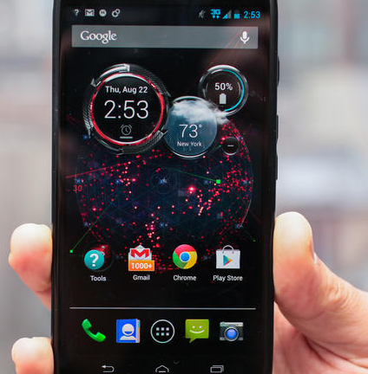



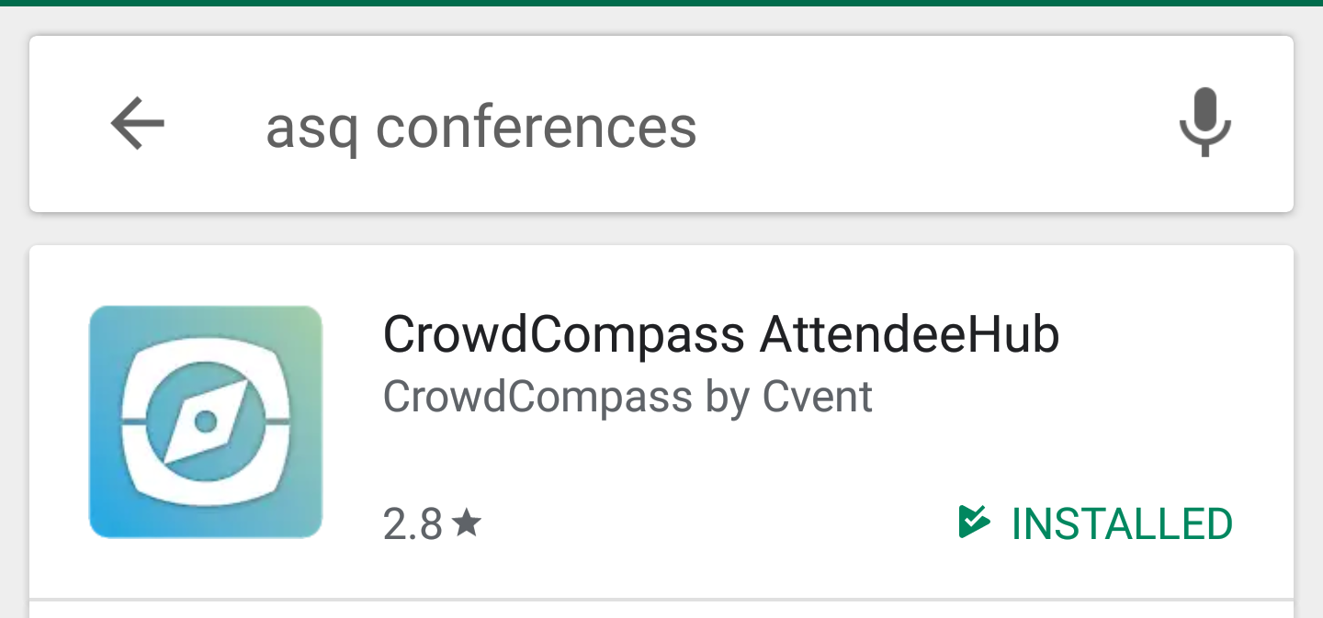
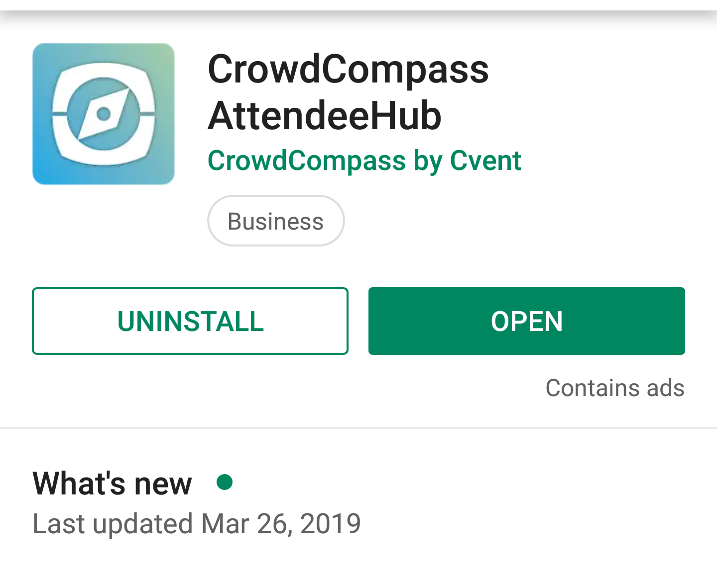
Resources: Conference App
Mobile Event Guide
ASQ Conferences: CrowdCompass AttendeeHub by CVENT
Find the app in:
The 2019 WCQI event within the app is not available yet and is expected to be released the week before the conference. The next few slides use a previous conference to demonstrate features of the app

Slide 39
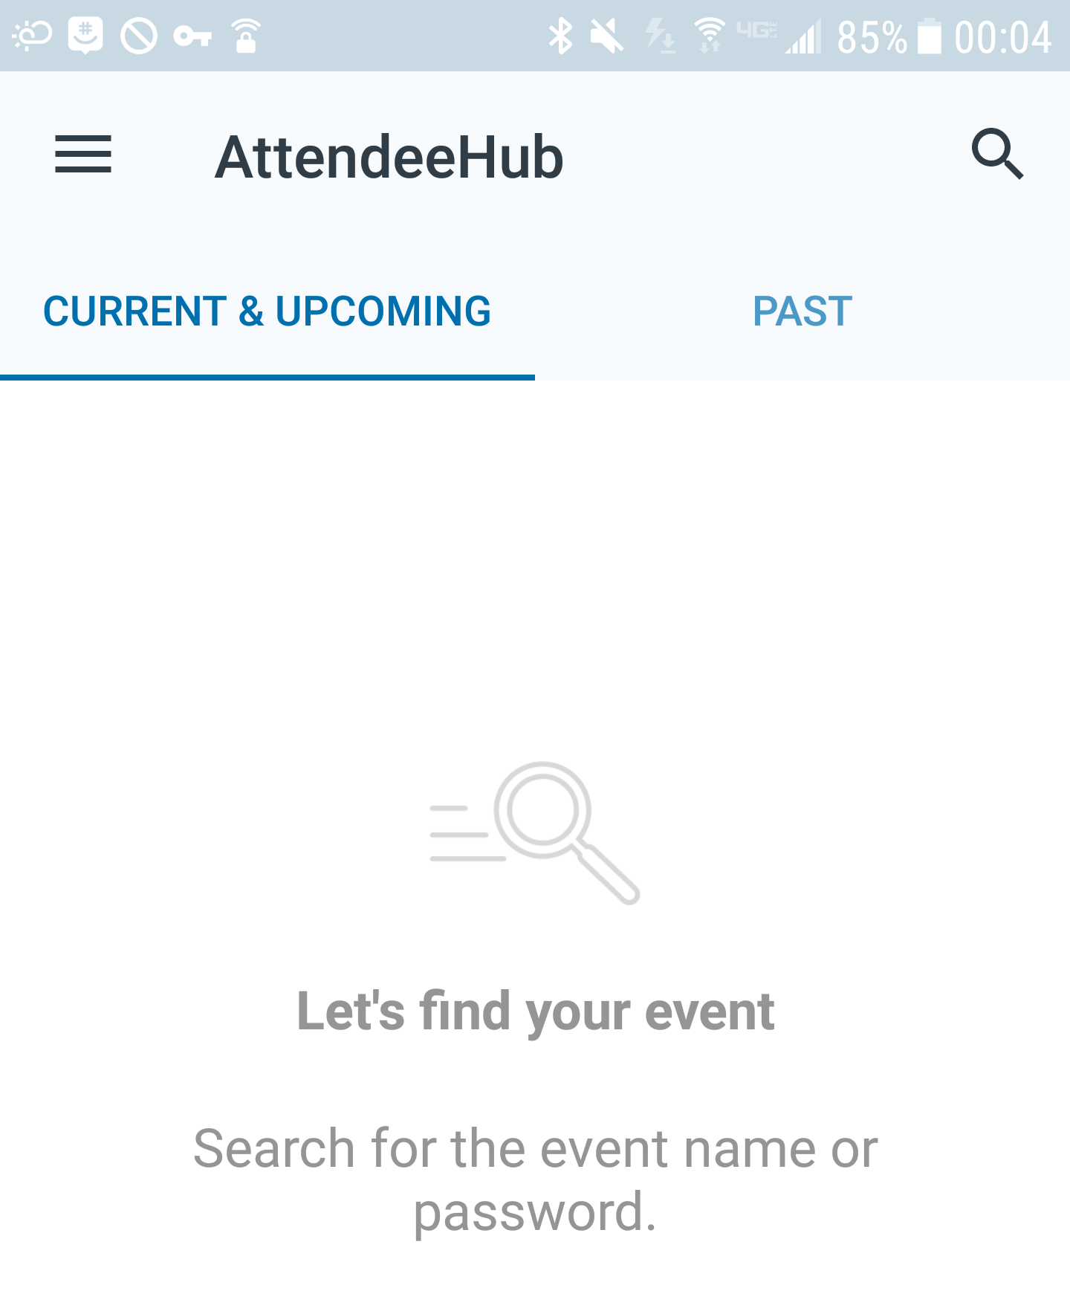
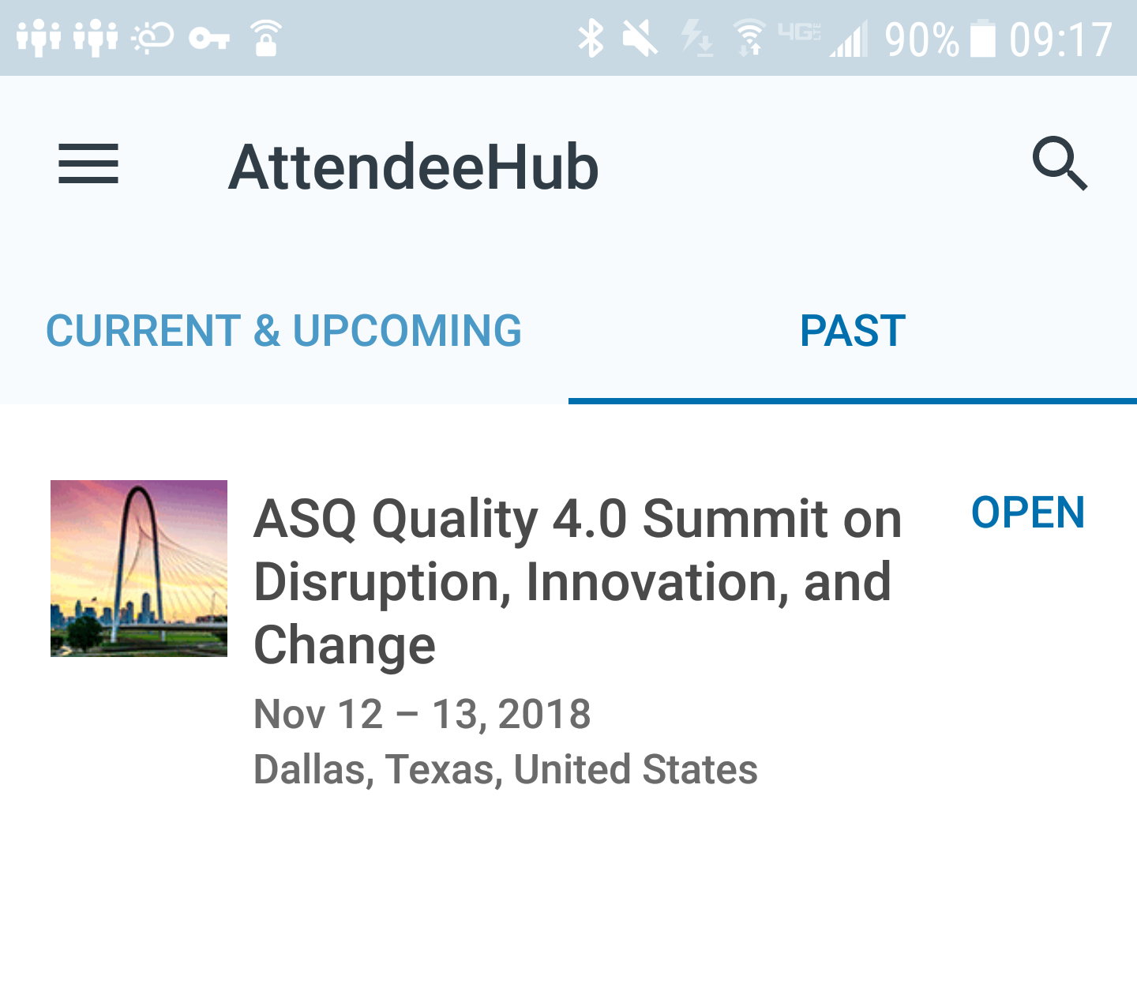
Resources: Conference App
The 2019 WCQI event will show in the Current & Upcoming tab when released, similar to the Quality 4.0 event that is in the Past tab

Slide 40
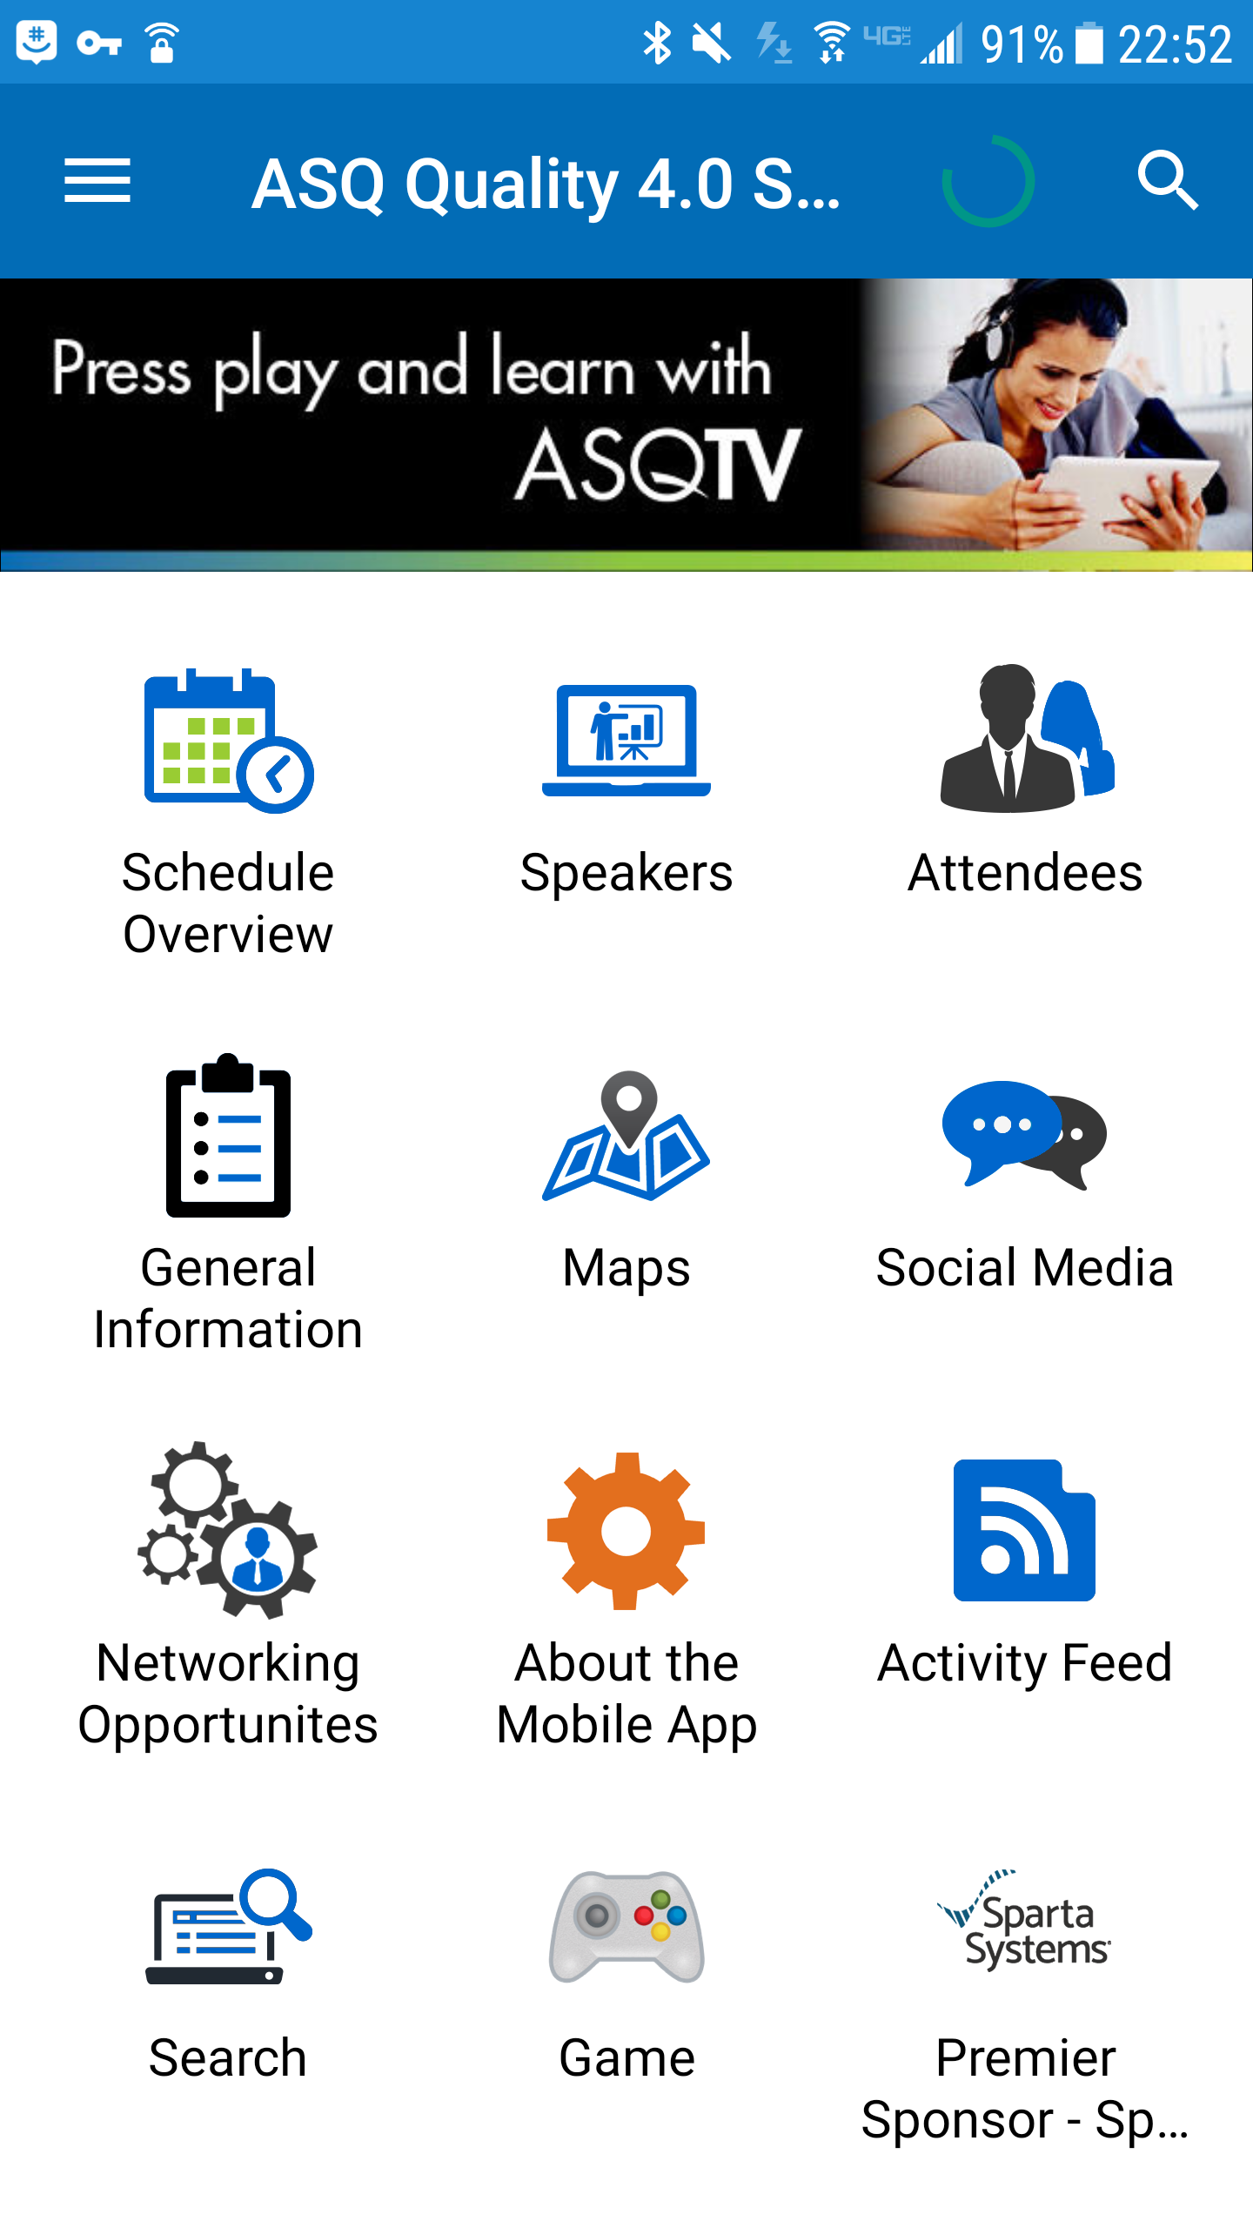
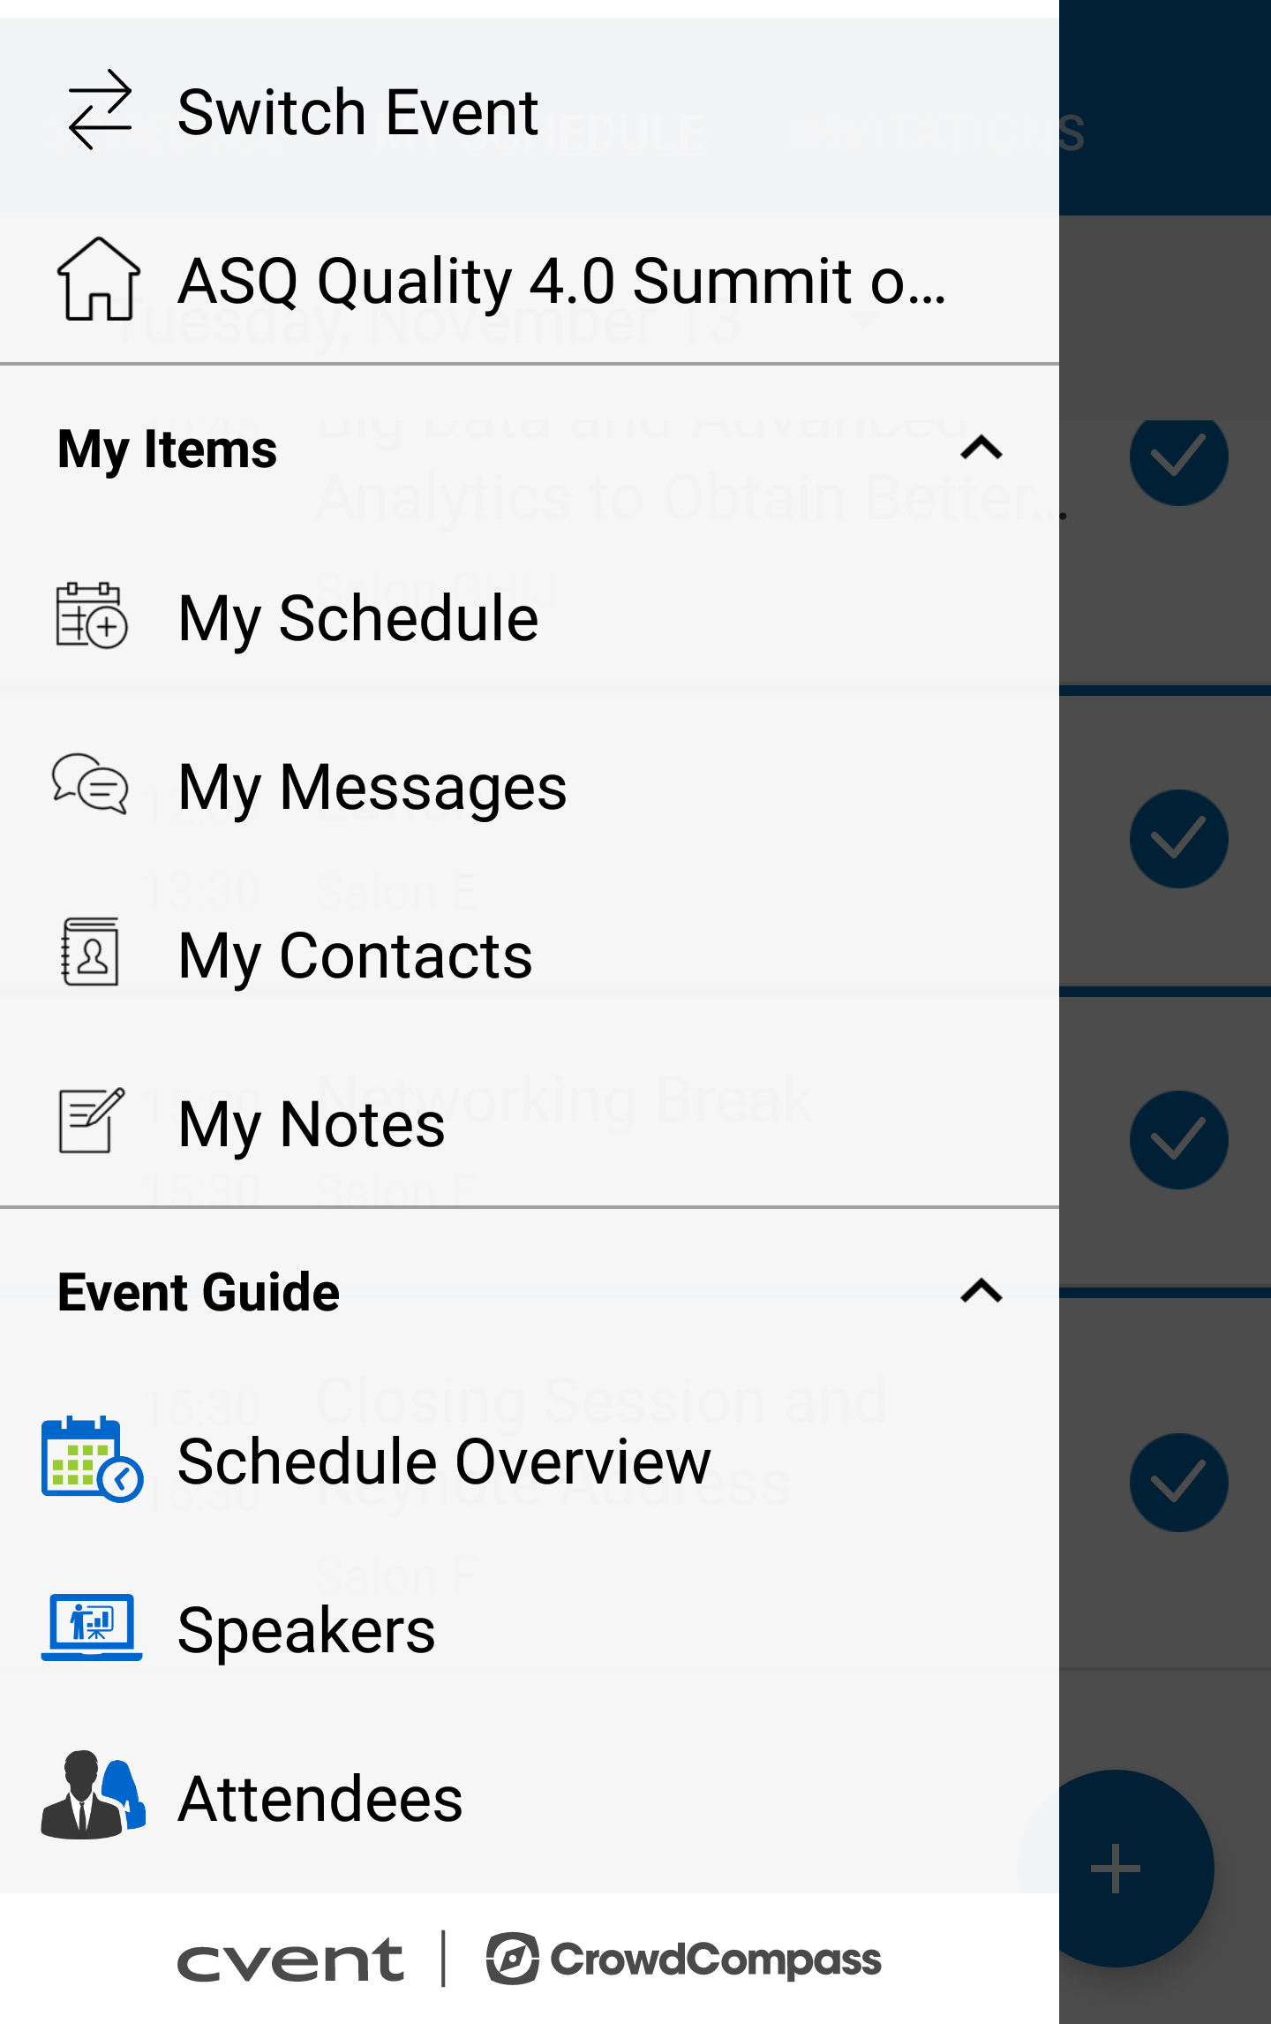
Resources: Conference App
When you open the event, you will see a list of icons.
Click on the Menu bar to access your personalizations, such as schedule. Click on the Home icon to return to the opening screen.

Slide 41
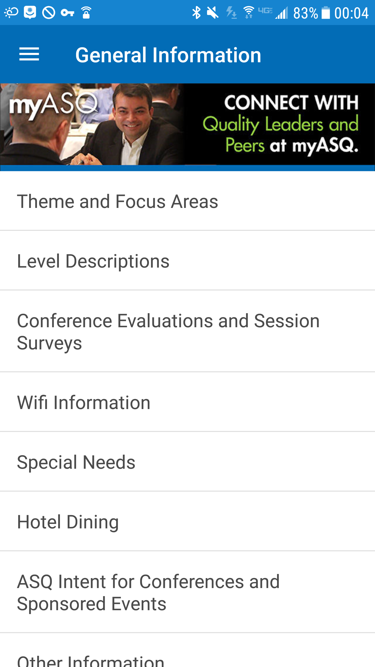
Resources: Conference App
General Information will provide information about the conference and venue.

Slide 42
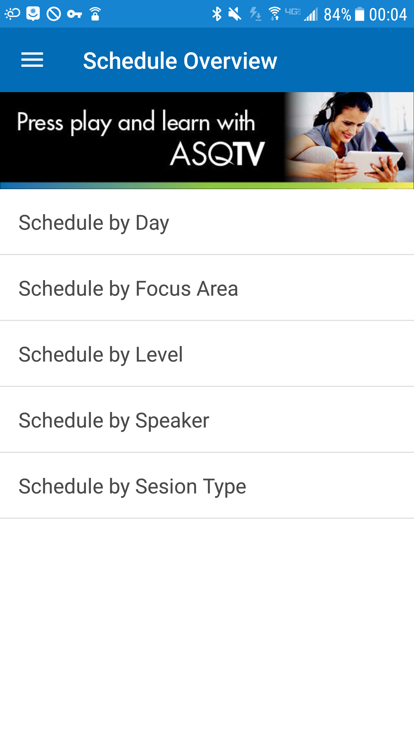
Resources: Conference App
Schedule Overview allows you to search the sessions different ways. You can then Bookmark or Add a session to your own schedule.
Notes:
.

Slide 43
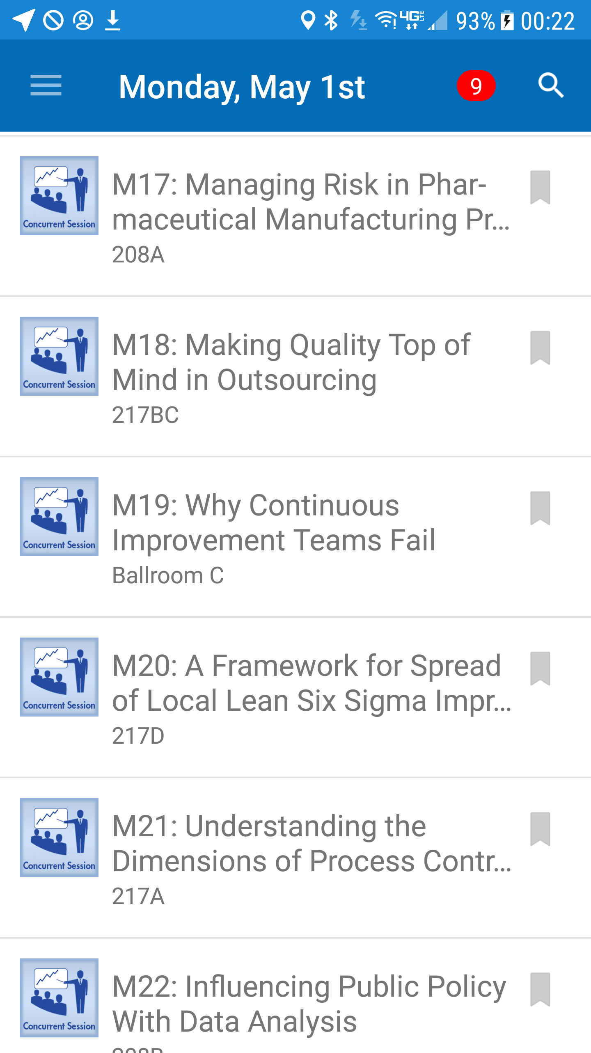
Resources: Conference App
One way to search the schedule is by day, which lists each session in time and session number order. In this example, we will look at Session M19

Slide 44
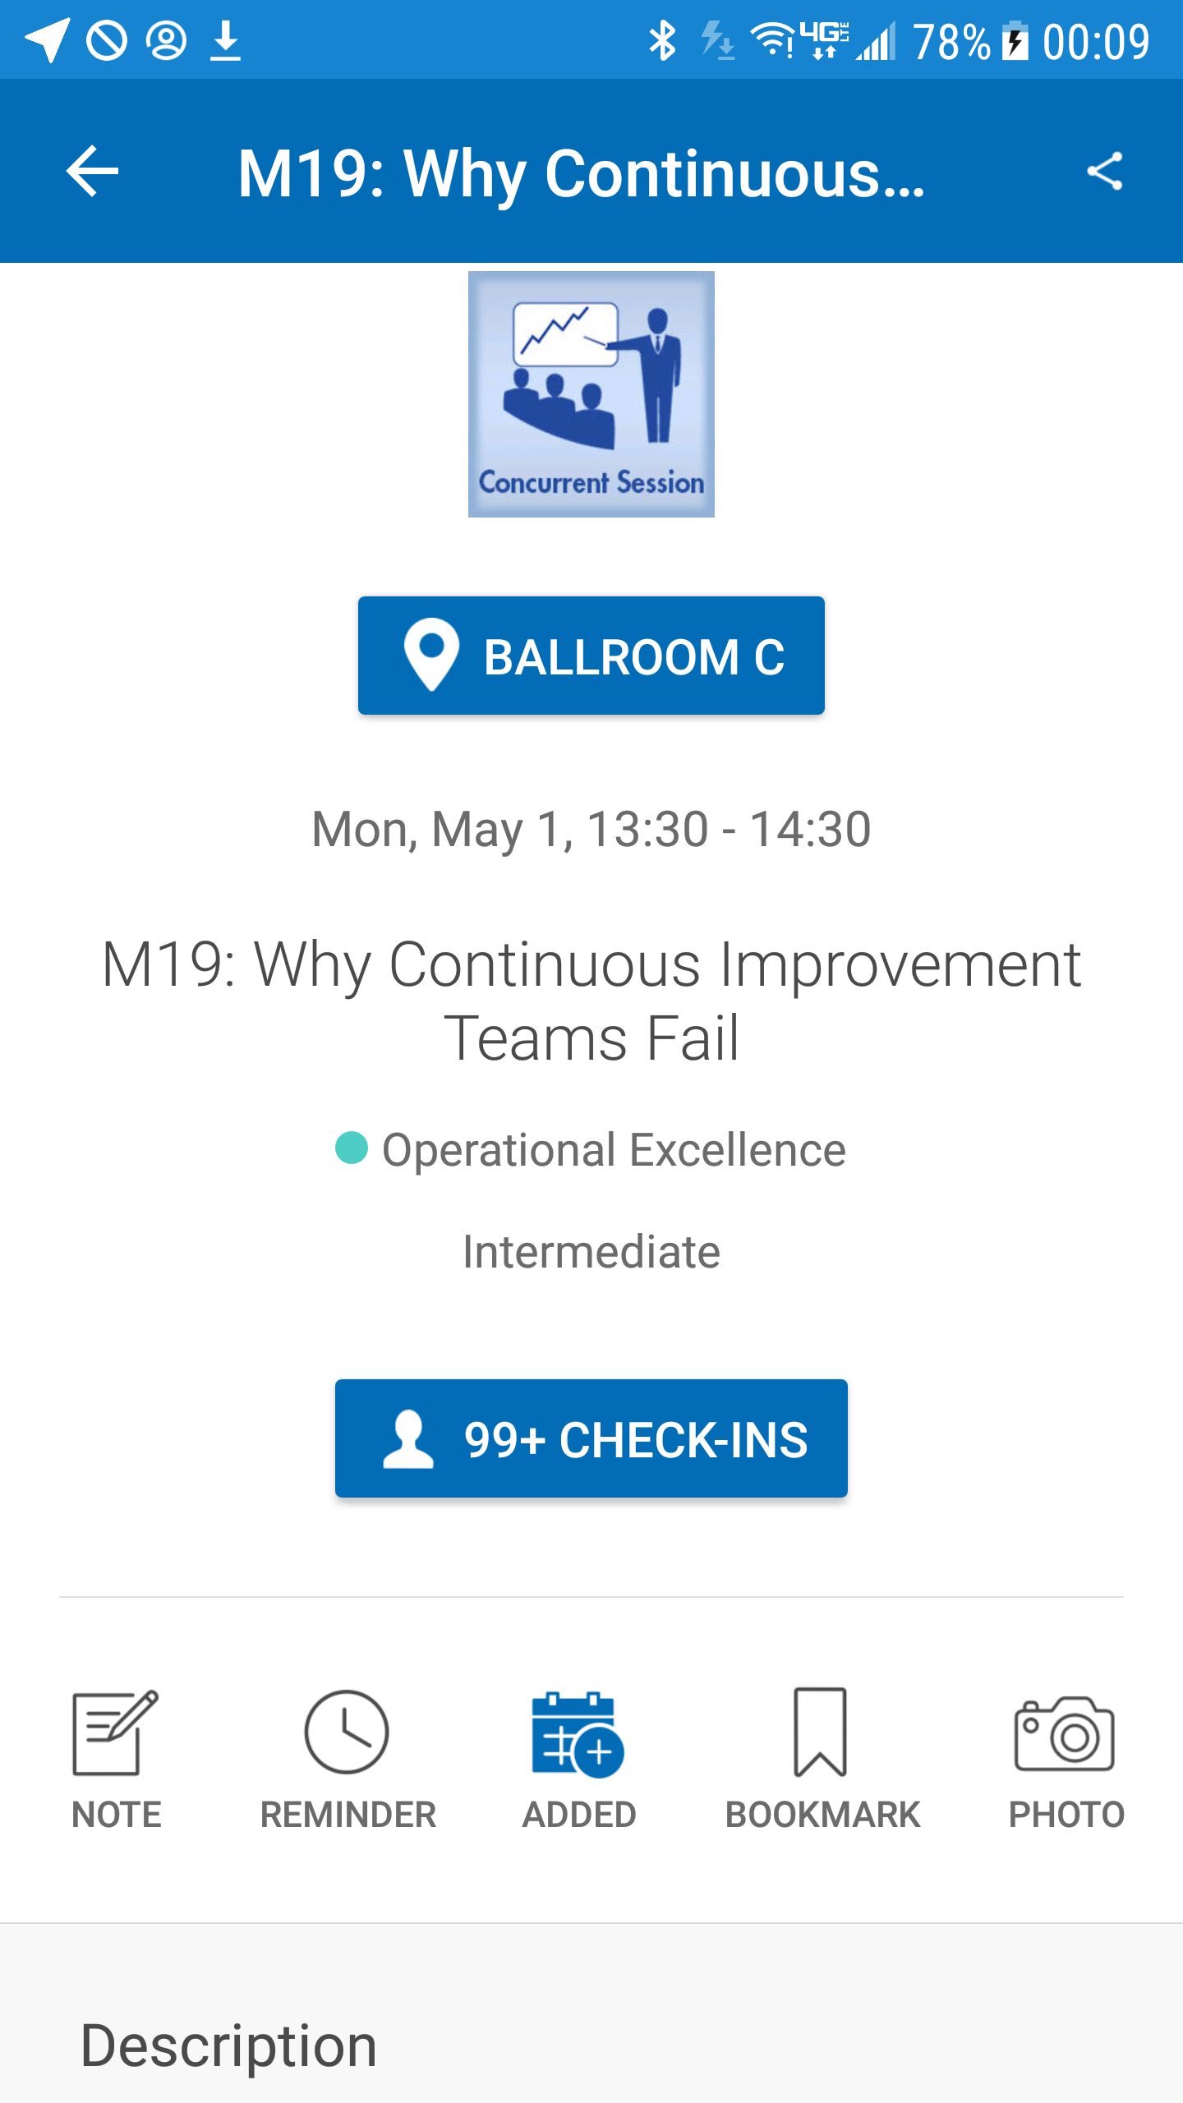
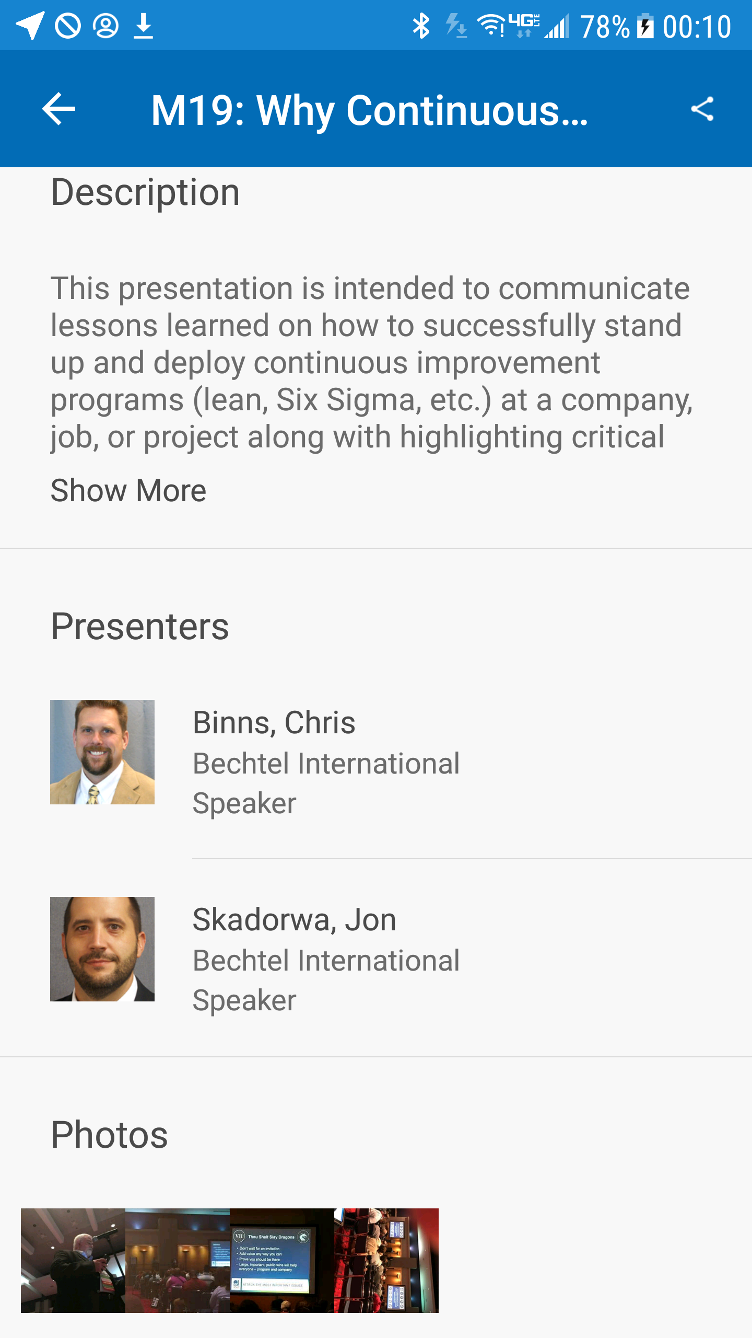
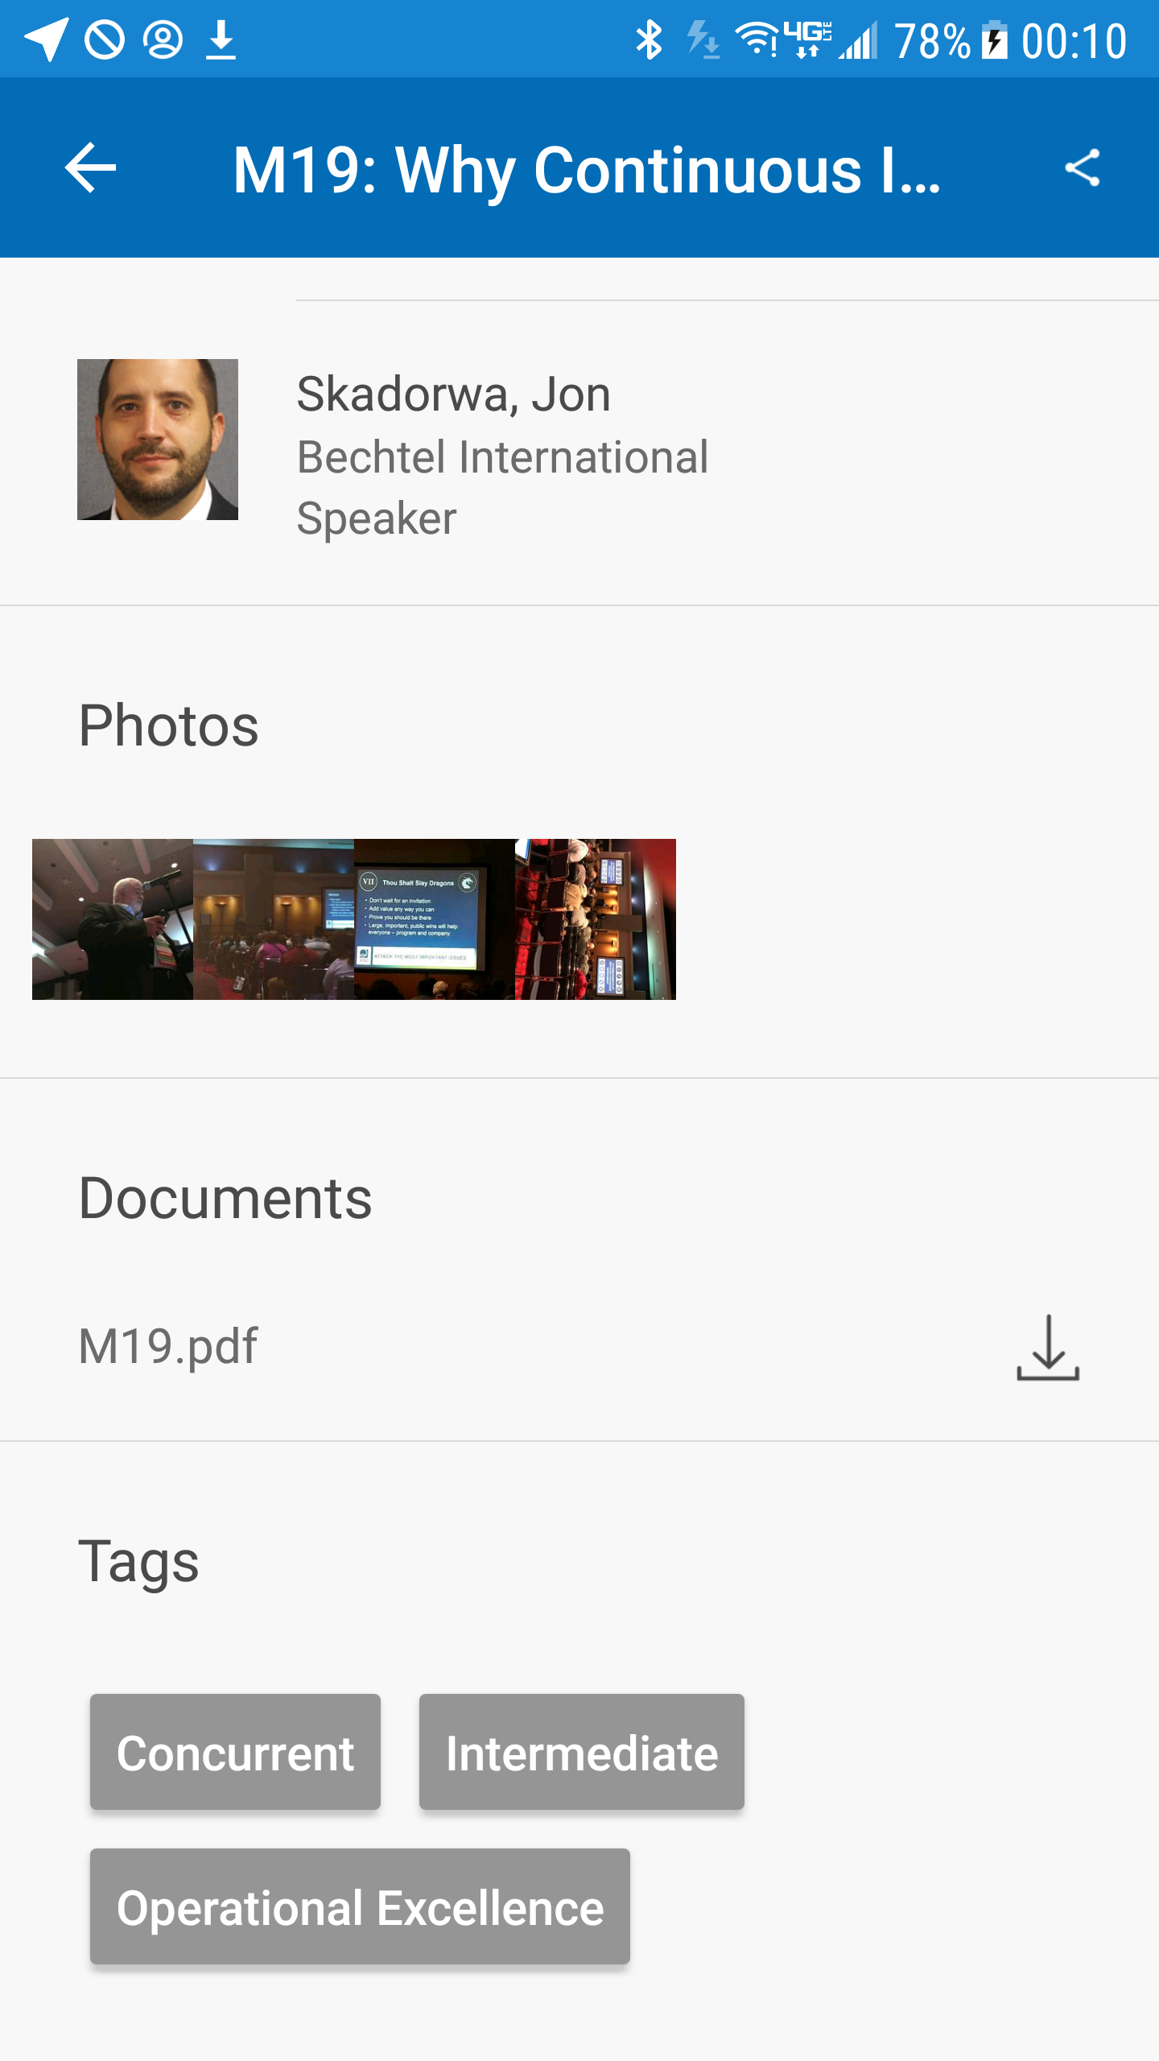
Resources: Conference App
Opening Session M19 will show the type of session, location, date/time, Focus area, level, description, speakers and any associated documents (presentation, handout, etc). When the event is live, this is where session evaluations will be completed.

Slide 45
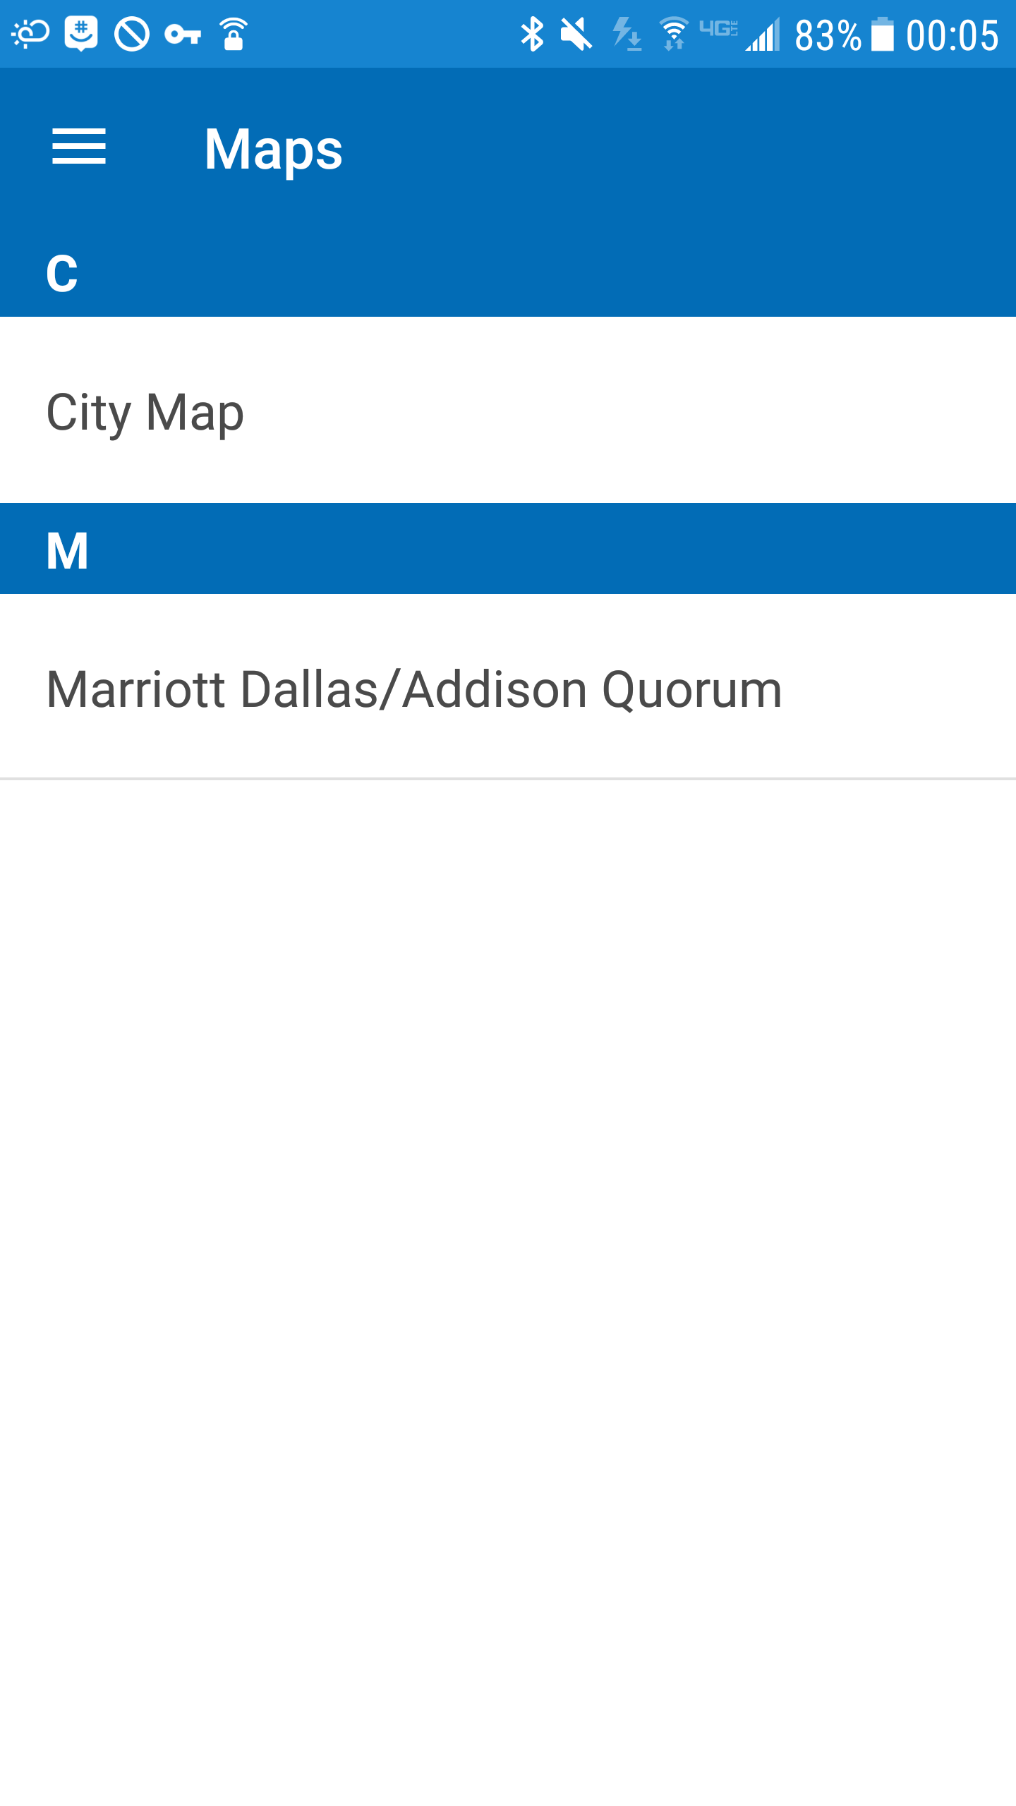
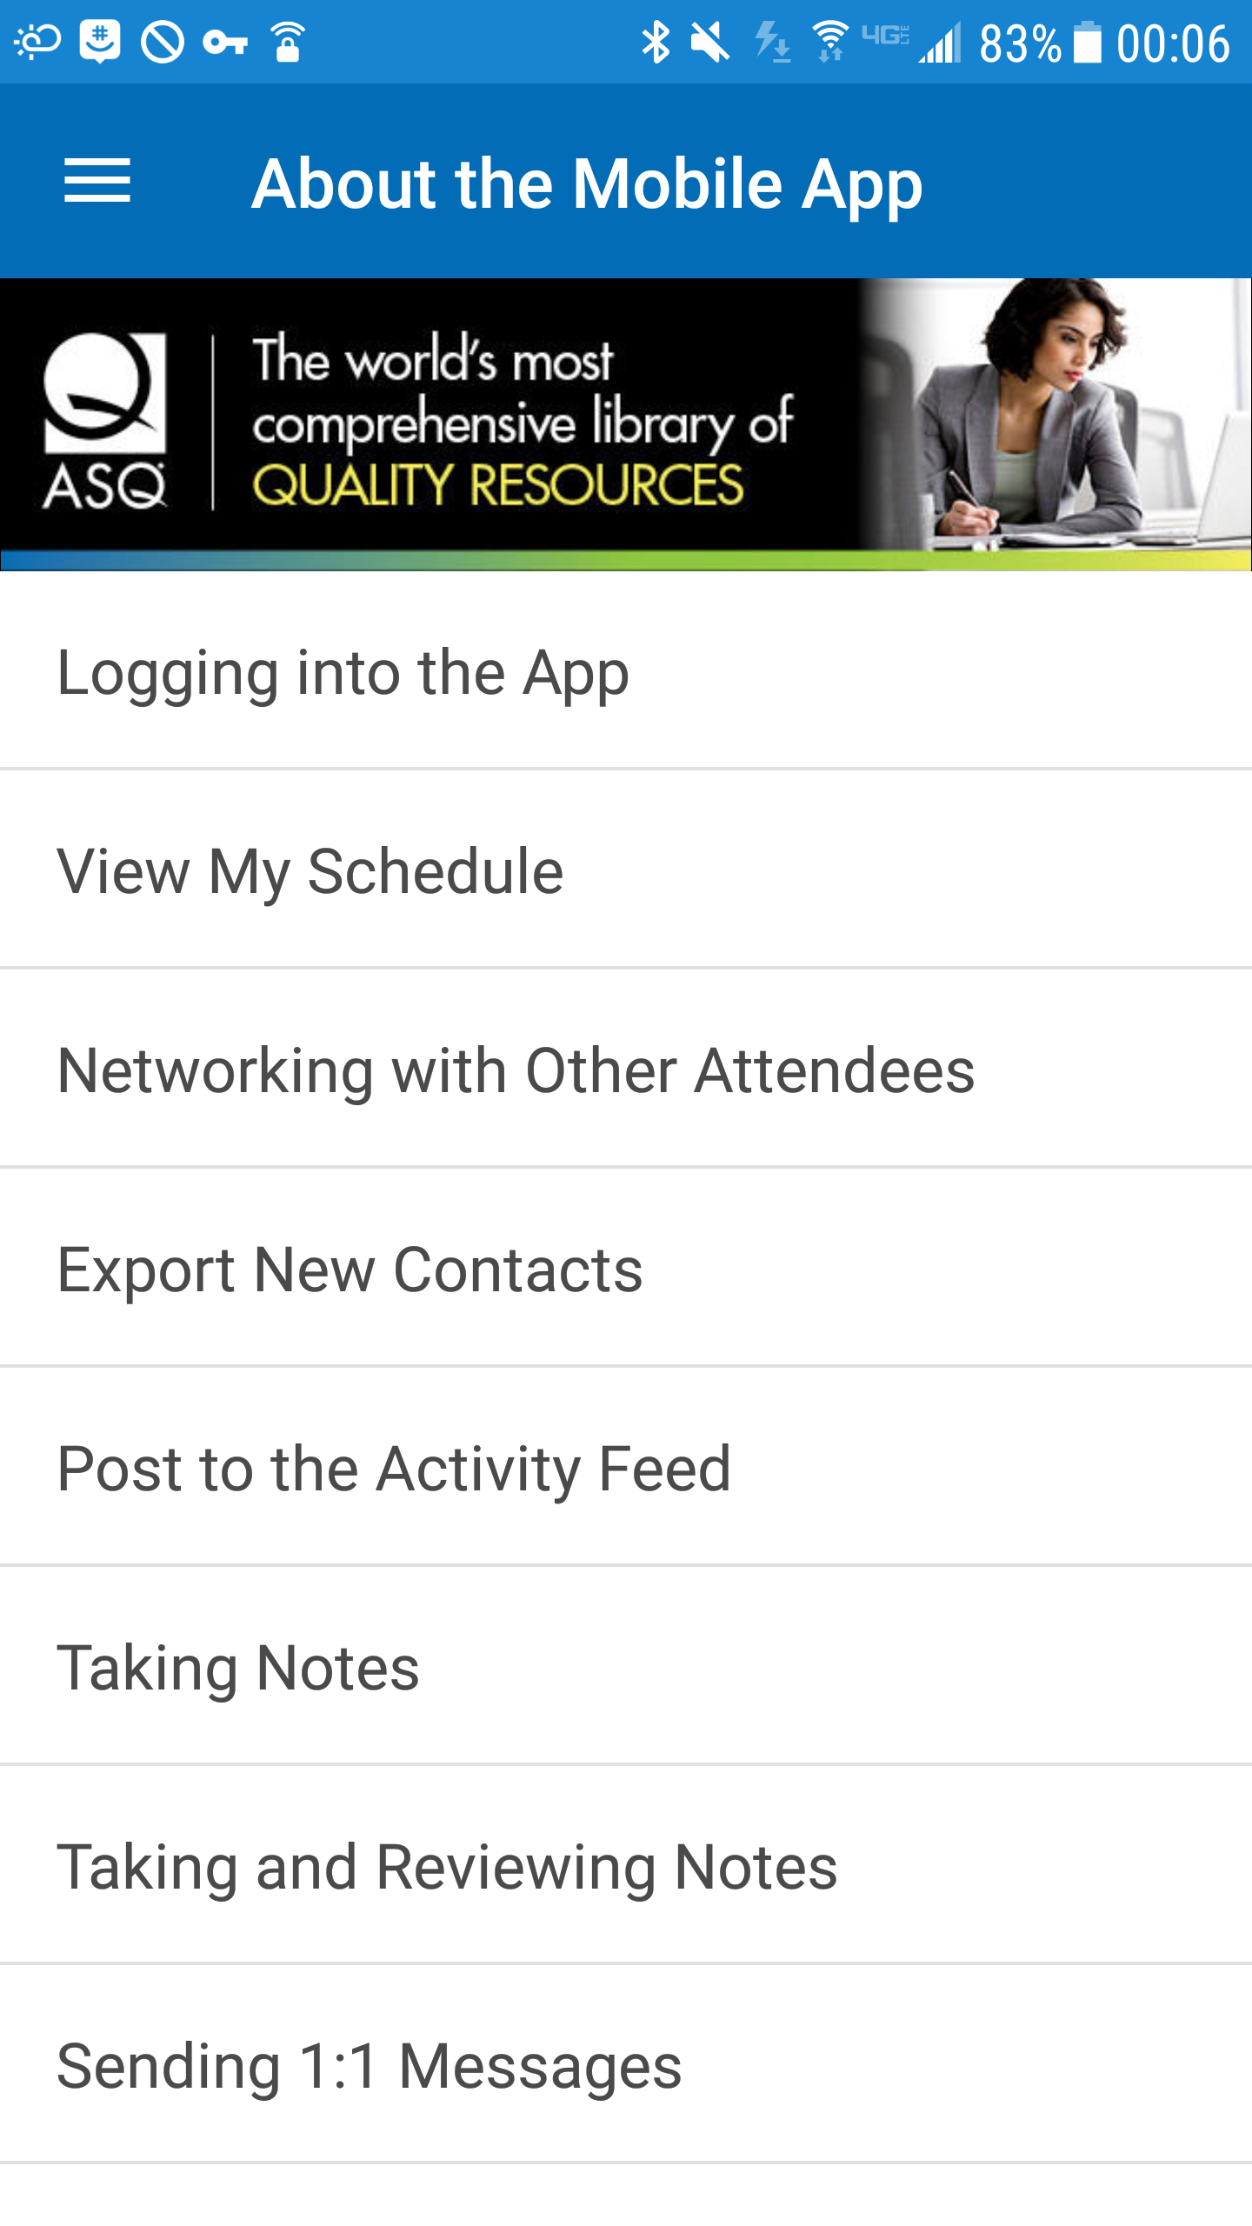
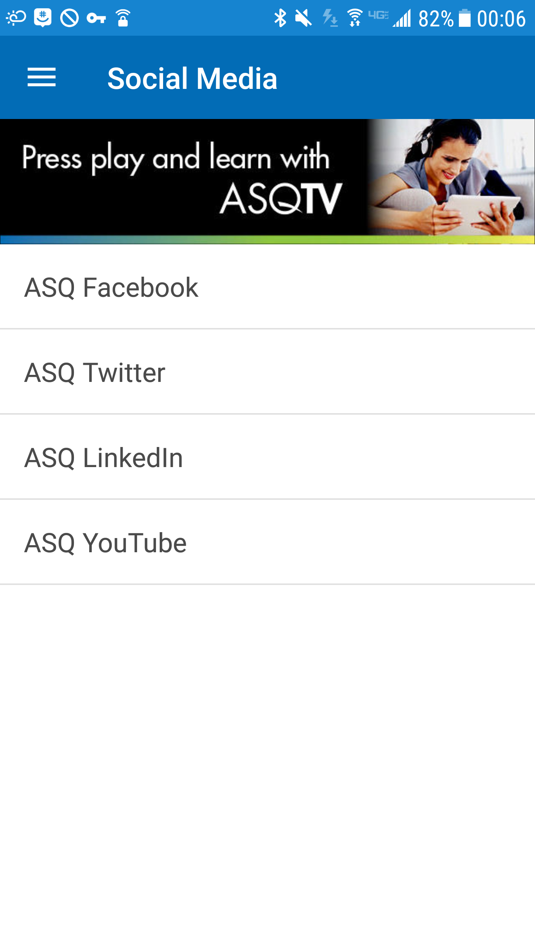
Resources: Conference App
The app has a lot of useful information that can be accessed quickly using the Search function. Once the event is released, take some time to review the features. This will be covered in more detail during the onsite training.

Slide 46
Resources: Websites
WCQI Schedule of Events - http://asq.org/wcqi/program.aspx This site is updated regularly, so you’ll need to check it out several times
Keynote speakers information - http://asq.org/wcqi/speakers.aspx
  International Team Excellence competition (Live Case Studies) - http://asq.org/team-excellence/index.aspx
Fort Worth Convention Center - https://www.fortworth.com/meetings/convention-center/
Fort Worth Visitor Information (What our city has to offer) - https://www.fortworth.com/
ASQ Fort Worth Conference Information - http://www.asqfortworth.org/wcqi-volunteers.html (Volunteers) http://www.asqfortworth.org/wcqi-ft-worth.html (General Information)

Slide 47
Next Steps

Slide 48
Next Steps
Volunteers must complete (and pass) the quiz by April 10, 2019
    Link is on next slide
    Those who pass will be provided the code to register for the conference at no cost!
      https://prdweb.asq.org/ecommerce/conference/
Email Updates:
  We will keep in touch with you by email in the next few weeks to:
  Your volunteer assignment schedules confirmed by April 30, 2019
  Other updates
  ONSITE Training:
As a volunteer, in addition to this ONLINE Training, you must attend an ONSITE Training session prior to your first assignment. This is mandatory.
Sessions are currently planned for:
Saturday 5/18 | Sunday 5/19 | Monday 5/20
9 AM | 11 AM | 7 AM
11 AM | 2 PM | 9 AM
1 PM | 4 PM

Slide 49
Next Steps: Quiz
Please note: This is Open Book!
You must score at least 80%. You may repeat as many times as necessary.
Quiz Link:
https://asq.co1.qualtrics.com/jfe/form/SV_esboIsU8qEtsRal
After you successfully complete the quiz, be sure to fill in the requested information so we know who completed it! You will also be asked to select a preferred time for onsite training to help us prepare.

Slide 50
Thank You From The Site Committee Team –
ASQ Greater Fort Worth Section 1416 and
ASQ Dallas Section 1402!
Role | Contacts
Site Committee Chairs | Fred Jenke / John Breckline
Registration | John Breckline / Sharon McNair
Scheduling | John Breckline / Jim Conkle
Training | David Greer / Peter Stamps
Site Room | Jerry Capstick / Russ Wood
Info Desk | Sharon McNair / Suran Wije

Slide 51
We look forward to seeing you in Fort Worth!
Please contact us with any questions -
2019 WCQI Training Coordinators:
David Greer dgreer82@gmail.com
Peter Stamps pstamps@sections.asq.org

